Slide 1
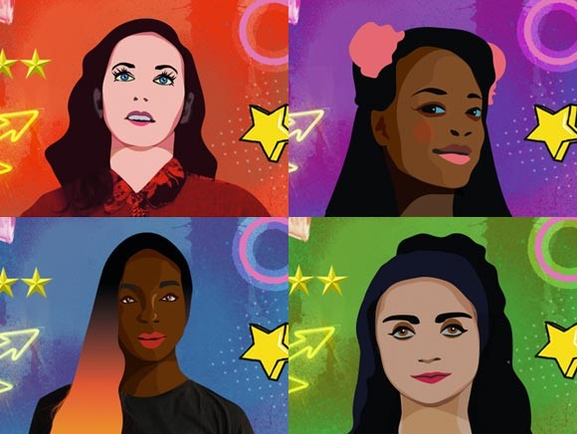
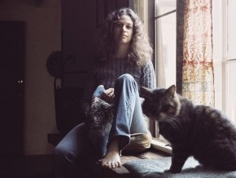
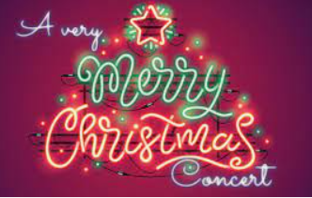
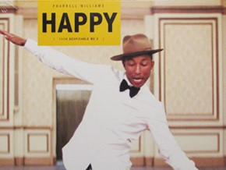
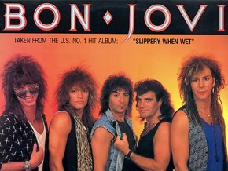
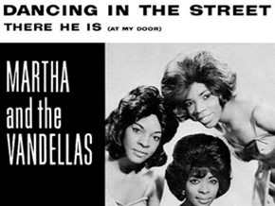
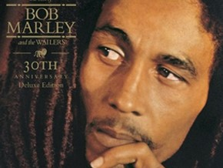
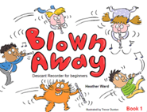
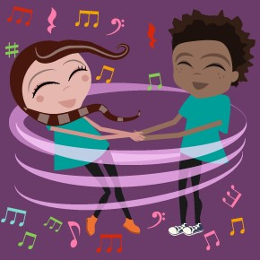
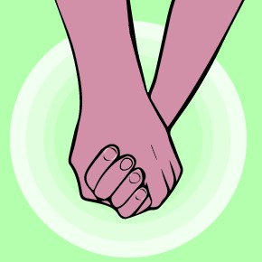
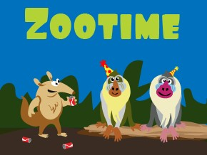
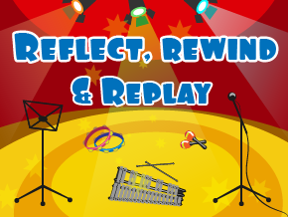
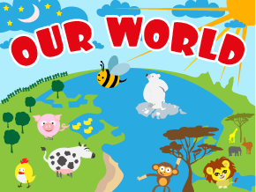
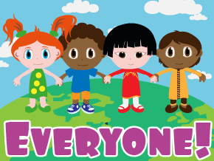
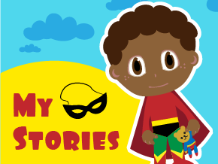
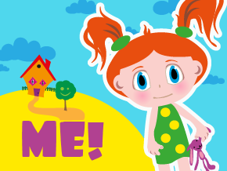
Secondary School
Music
Curriculum Pathway
Music and Me
You've got a friend
Classroom Jazz
Christmas Performance
Happy
End of Year Performance
UKS2
Year 6
Living on a Prayer!
Make you feel my love
The French Prince of Bel-Air
.
Reflect, Rewind and Replay
Classroom Jazz
UKS2
Year 5
Dancing in the Street
.
Reflect, Rewind and Replay
Blackbird
Mamma Mia!
Stop!
Christmas Performance
Glockenspiel Stage 2
Recorder
Unit 1
Bring us Together
.
Reflect, Rewind and Replay
Glockenspiel Stage 1
LKS2
Year 4
Friendship Song
Christmas Performance
LKS2
Year 3
KS1
Year 2
Your
Your Imagination
8
KS1
Year 1
EYFS
Nursery
”
!

